Slide 1

Bank Marketing Campaign
Name: Vijayarajan Vijaya Jothi
Location: United Kingdom
Project: Data Science
Date:15/11/2024

Slide 2


Agenda
Executive Summary
Problem Statement
Approach
EDA
EDA Summary
Recommendations

Slide 3
Executive Summary
Problem Statement:
• ABC Bank wants to sell its term deposit product to customers and before launching the product they want to develop a model which help them in understanding whether a particular customer will buy their product or not (based on customer's past interaction with bank or other Financial Institution).
ML Problem:
• With an objective to gather insights on the factors that are impacting the persistency, build a classification for the given dataset.
The highest model accuracy and precision were attained using the Random Forest Classifier model.

Slide 4
Problem Statement
Business Understanding:
Bank wants to use ML model to shortlist customer whose chances of buying the product is more so that their marketing channel (tele marketing, SMS/email marketing etc) can focus only to those customers whose chances of buying the product is more. This will save resource and their time (which is directly involved in the cost ( resource billing)).Develop model with Duration and without duration feature and report the performance of the model. Duration feature is not recommended as this will be difficult to explain the result to business and also it will be difficult for business to campaign based on duration.

Slide 5

Approach
Business Understanding
Importing Required libraries and dataset
Exploratory Data Analysis
Data processing and transformation
Model Building
Model evaluation
Model Deployment

Slide 6
Exploratory Data Analysis
Bank Marketing Campaign
• File Used: bank-additional-full.csv
• Correlation between all variables and the predictor.
• Missing data or nulls exist and have been handled.
• Data wrangling transformation included normalizing data and standardize them.
• This has increased the correlation between the features and the predictor variable.
• Dummy variables have been created (Categorical variables to 0 and 1)

Slide 7
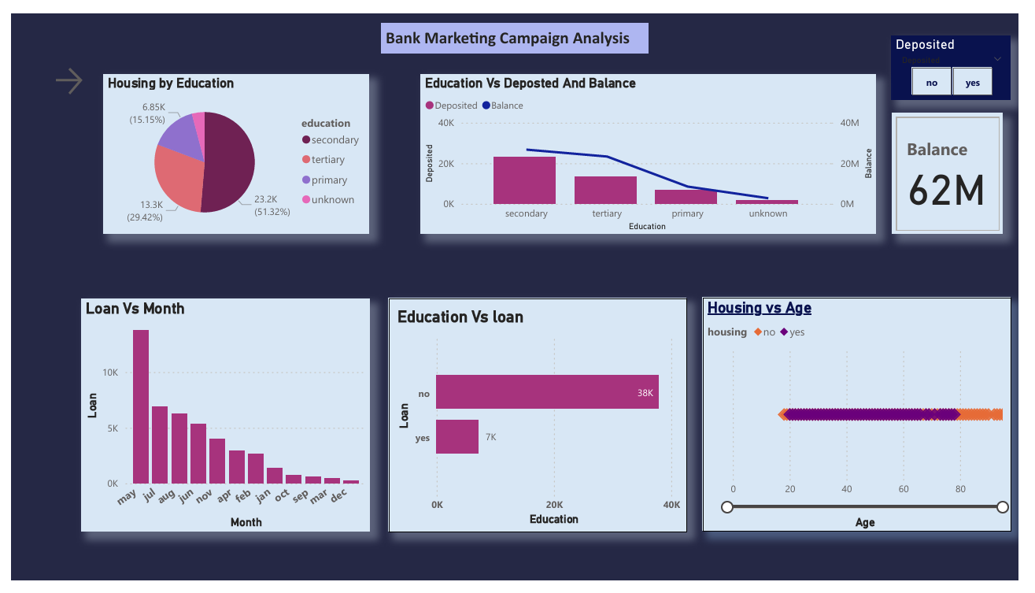
Exploratory Data Analysis
Bank Marketing Campaign
• File Used: bank-additional-full.csv
• Visual elements in the Dashboard
gives insights about
Customer base.
• Pie Chart shows Majority Customers having housing have obtained Secondary Education .
• Combo chart visualizations shows Customers with Secondary Education having higher balance and Deposits in Bank.
• From Charts, “May”, Month remain the highest Loan applied.
• Also, Customers between Age 20 and 80 having housing ownership.

Slide 8
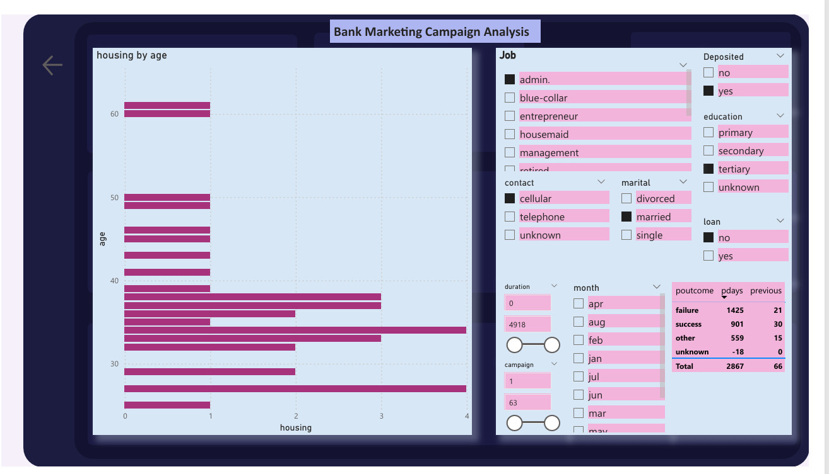
Exploratory Data Analysis
Bank Marketing Campaign
• File Used: bank-additional-full.csv
• Visual elements in the Dashboard
gives insights about
Customer base.
• From charts, Customers in classes of admin, cellular, and married , having deposits and possess no loan and obtained tertiary education,
Got Housing ownership between 20 and 60 .
• From Charts, Customers between age 30 to 40 falling in the above filtered conditions, have maximum housing ownership.

Slide 9
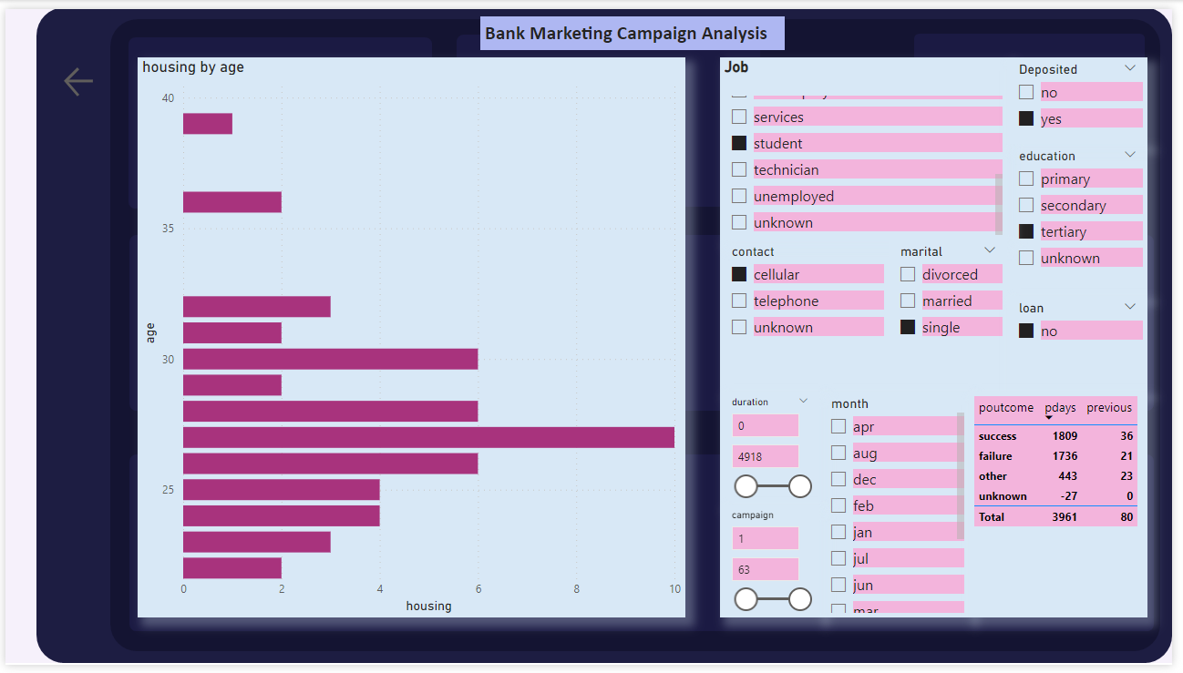
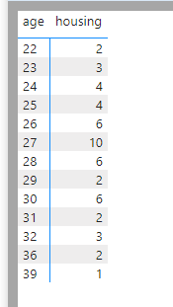
Exploratory Data Analysis
Bank Marketing Campaign
• File Used: bank-additional-full.csv
• Visual elements in the Dashboard
gives insights about
Customer base.
• From charts, Customers in classes of student, cellular, and single , having deposits and possess no loan and obtained tertiary education,
Got Housing ownership between 22 and 39 .
• From Charts, Customers between age 23 to 32 falling in the above filtered conditions, have maximum housing ownership.

Slide 10
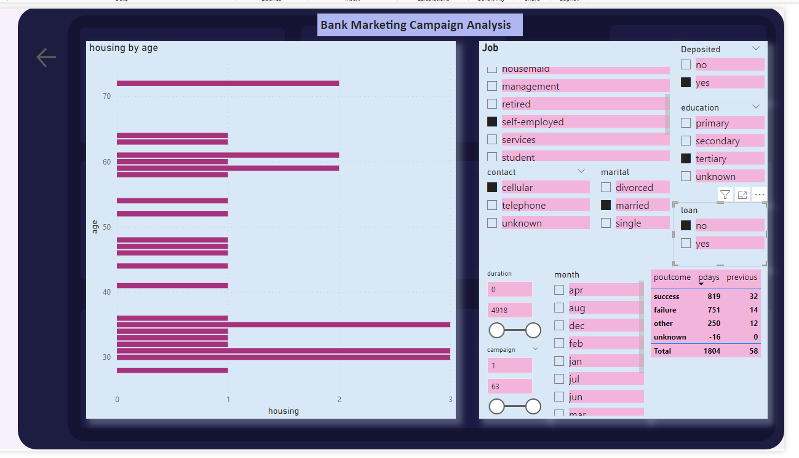
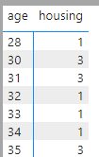
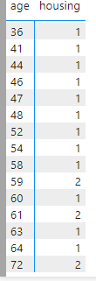
Exploratory Data Analysis
Bank Marketing Campaign
• File Used: bank-additional-full.csv
• Visual elements in the Dashboard
gives insights about
Customer base.
• From charts, Customers in classes of self-employed, cellular, and married , having deposits and possess no loan and obtained tertiary education,
Got Housing ownership between 28 and 72 .
• From Charts, Customers between age 28 to 35 falling in the above filtered conditions, have maximum housing ownership.

Slide 11
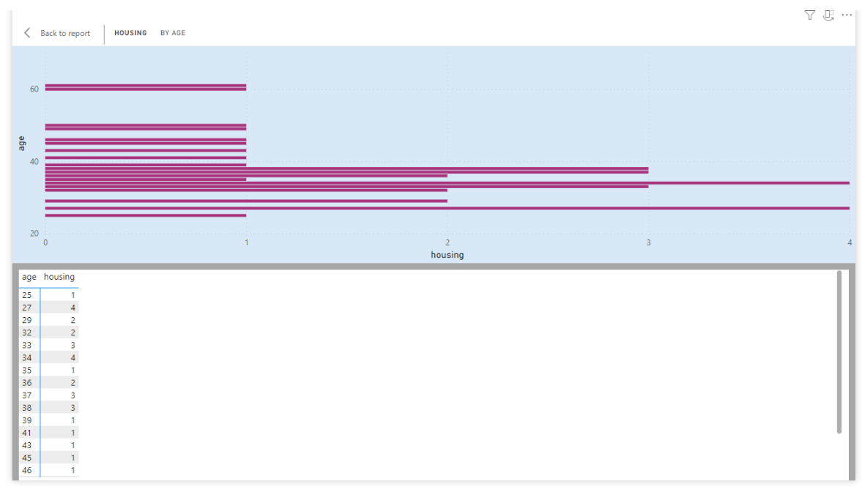
Exploratory Data Analysis
Bank Marketing Campaign
• File Used: bank-additional-full.csv
• Visual elements in the Dashboard
gives insights about
Customer base.
• From charts, Customers in classes of admin, cellular, and married , having deposits and possess no loan and obtained tertiary education,
Got Housing ownership between 20 and 60 .
• From Charts, Customers between age 30 to 40 falling in the above filtered conditions, have maximum housing ownership.

Slide 12
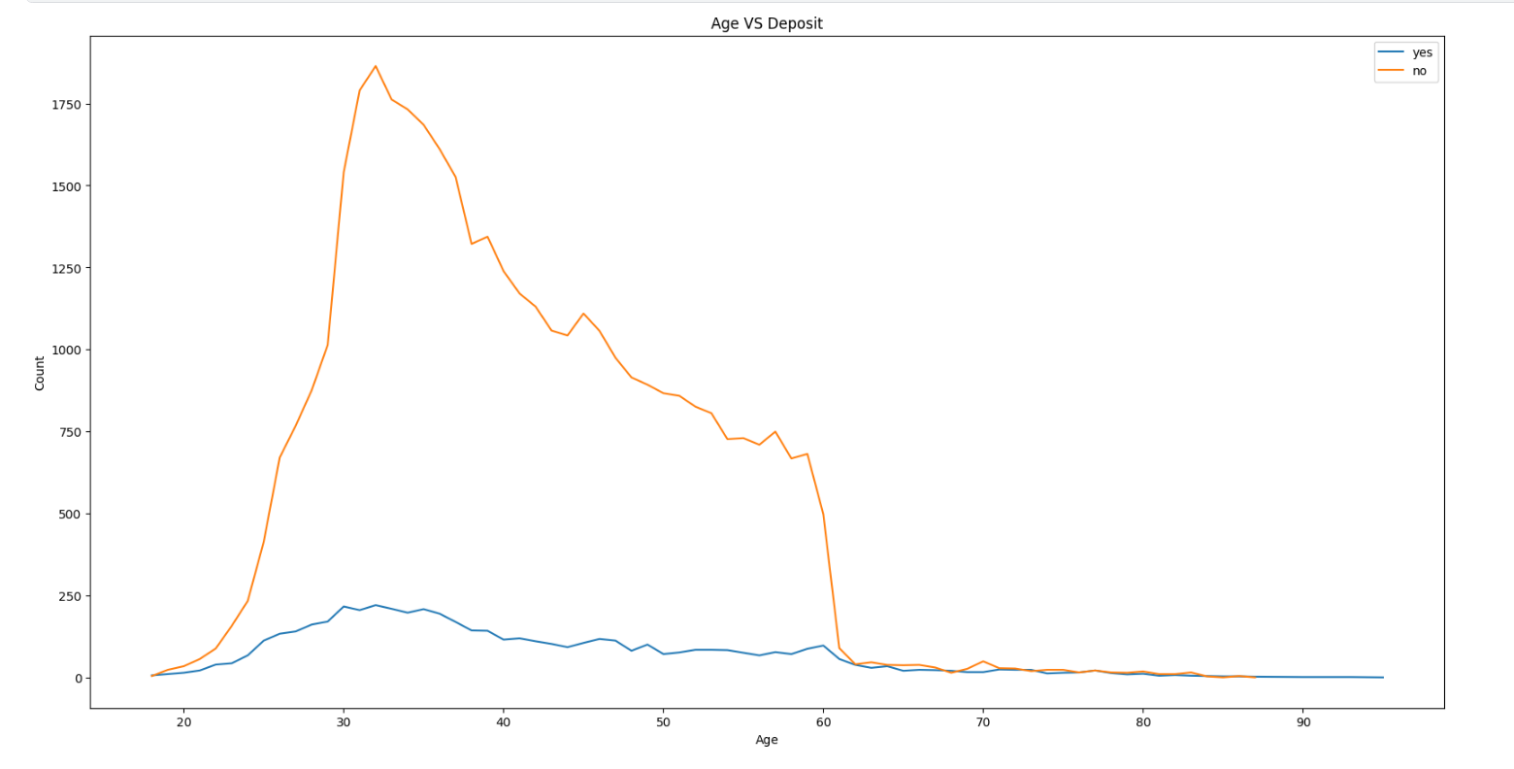
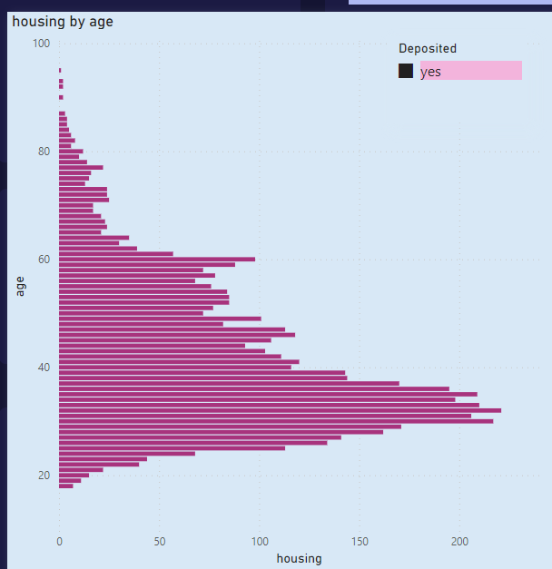
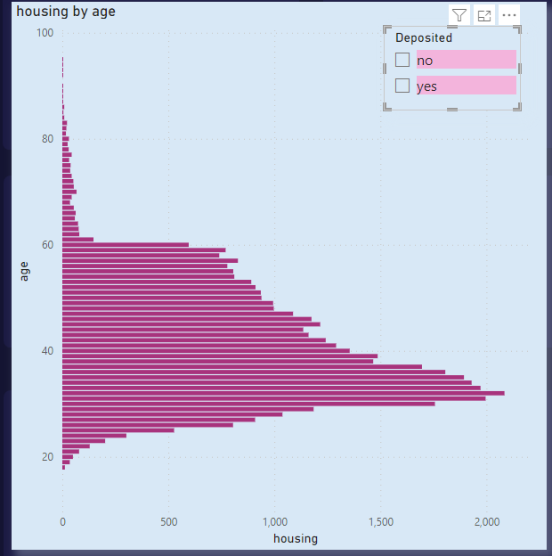
Exploratory Data Analysis
Bank Marketing Campaign
• File Used: bank-additional-full.csv
•The line graph shows customers between Age 20 and 60 have Deposits in Bank.

Slide 13
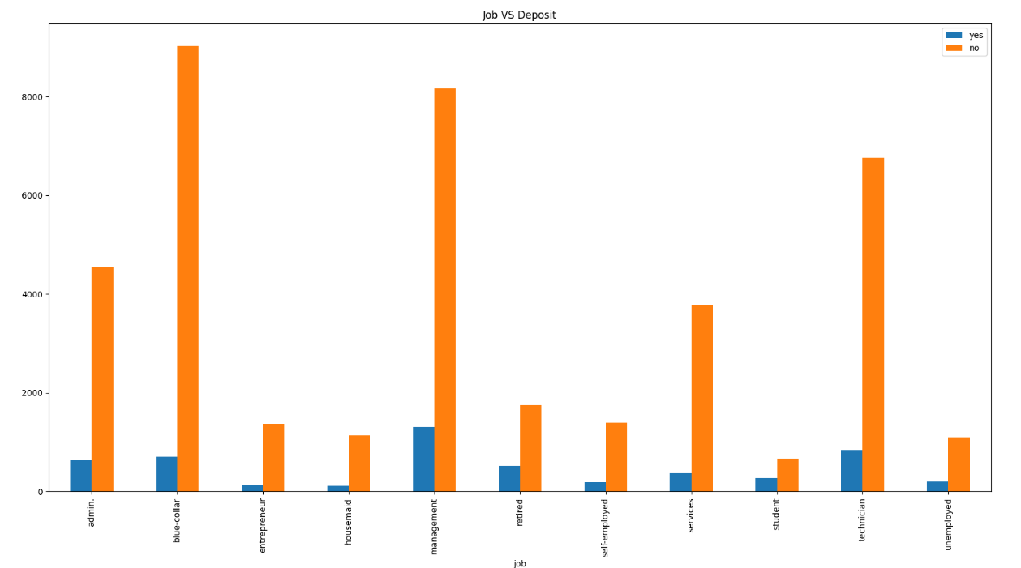
Exploratory Data Analysis
Bank Marketing Campaign
• File Used: bank-additional-full.csv
•The Stacked Column Chart shows Customers having Deposit based on job.
From charts, it is explained that customer having management jobs have comparatively got higher Deposits in Bank.

Slide 14
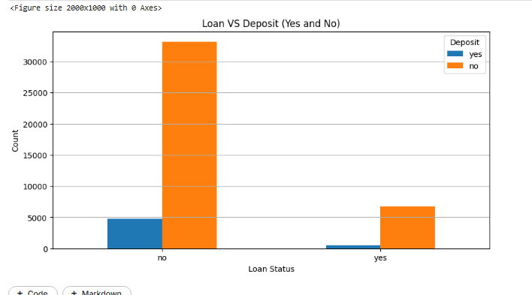
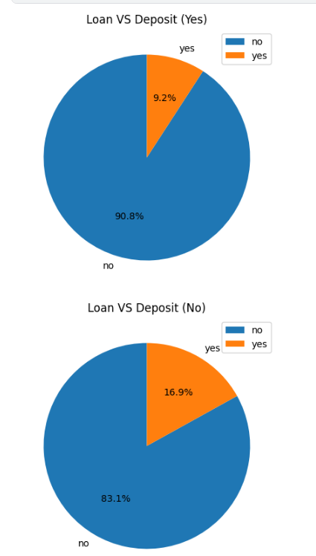
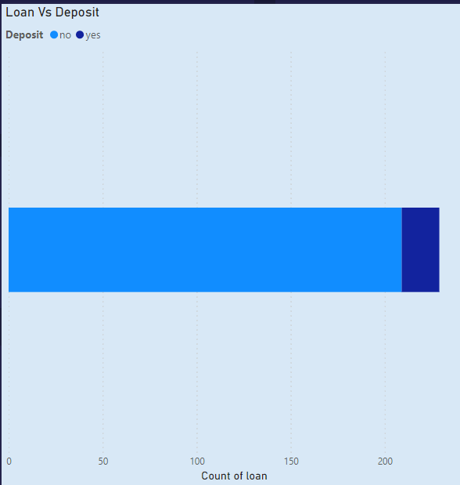
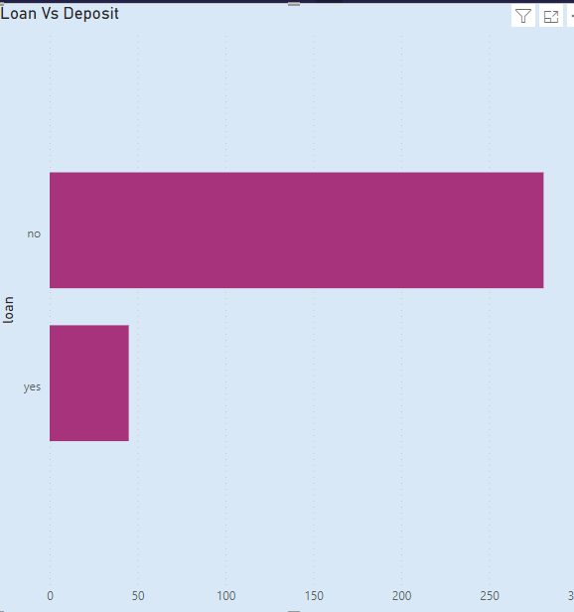
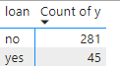
Exploratory Data Analysis
Bank Marketing Campaign
• File Used: bank-additional-full.csv
•The First Pie chart shows 9.2% of customers with Deposit have Loan in bank
• File Used: bank-full.csv
•The Second Pie chart shows 16.9% of customers with Deposit have no loan in bank

Slide 15
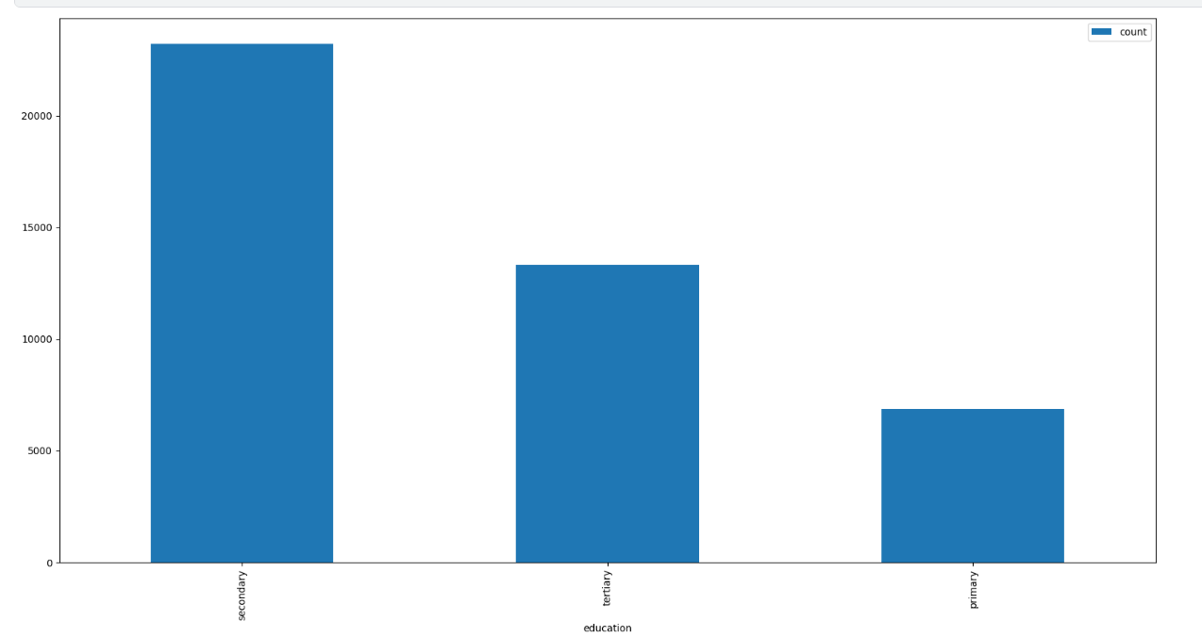
Exploratory Data Analysis
Bank Marketing Campaign
• File Used: bank-additional-full.csv
•The Column Chart shows Customers having Secondary Education have higher deposits in Bank

Slide 16
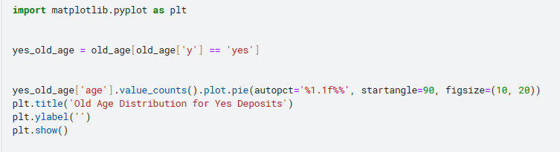
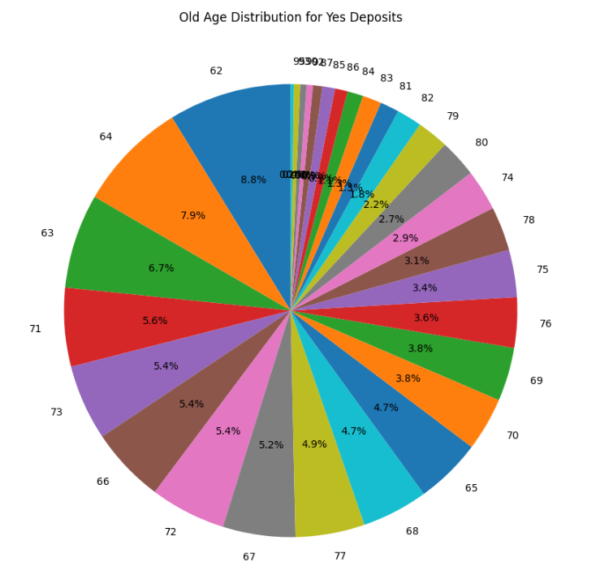
Exploratory Data Analysis
Bank Marketing Campaign
• File Used: bank-full.csv
•The Pie Chart shows Distribution of Old Age Customers having deposits in Bank.
About 8.8% of customers in Old Age 62 have max Deposits in Bank .

Slide 17
Recommendations
Based on the analysis with the dataset for the Bank Marketing Campaign, several key business recommendations can be formulated to enhance the bank's marketing strategy for term purchases
It is strongly recommended that the bank could directs its marketing efforts towards married couples. The Analysis chart indicates that the married individuals have demonstrated a notably higher chances of purchasing in term deposits.
The target demographic have to be considered as primary focus for the bank's promotional activities.
The bank can consider tailoring its marketing Campaign towards tertiary graduated individuals. This demographic has shown a higher propensity for term purchases, suggesting that targeting this educated group may yield higher chances of conversions. Individuals without outstanding loans should be a priority in the bank's marketing strategy.
The bank can concentrate its marketing endeavours on individuals in their late twenties to early forties.
The bank can concentrate on the customers with housing availability for their term deposit product promotion# The demographic satisfying the classes can be identified to execute Bank Marketing Campaign as demonstrated in the above Exploratory Data Analysis.

Slide 18
Model Building
The case is classification so we will be using three models:
Logistic Regression,
Ridge Regression,
Random Forest classifier.

Slide 19
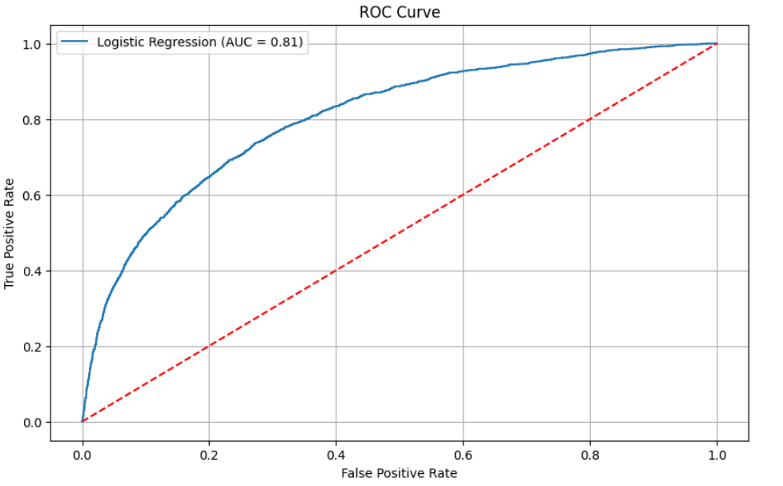
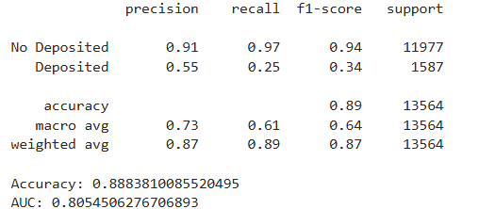
Logistic Regression Model Results

Slide 20
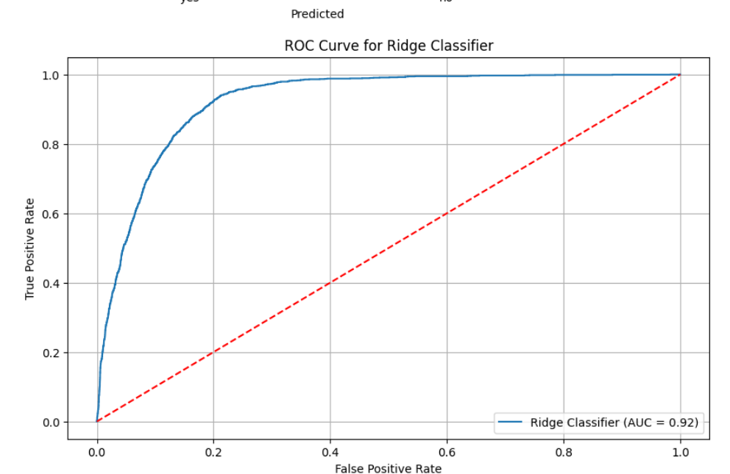
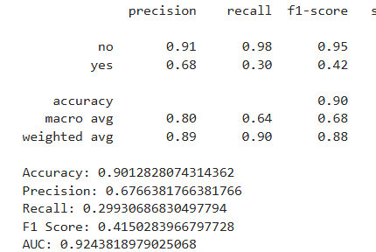
Ridge Regression Model Results

Slide 21
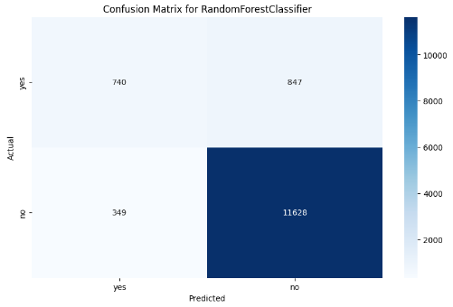
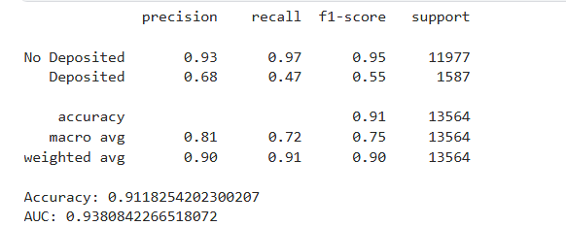
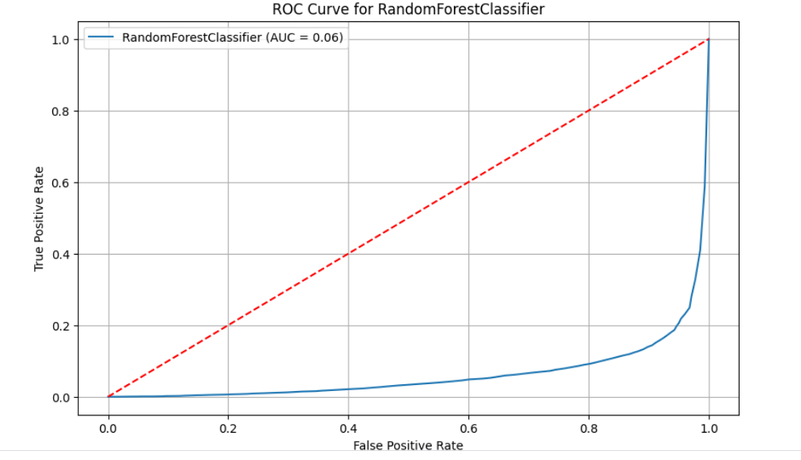
Random Forest Classifier Model Results
0.94

Slide 22
Income Class wise Profit and customer base Analysis
Customer Retention
Random Forest Model
ModelTrade-offs:
Advantages:
• Insensitive to Outliers.
• Insensitive to Null values.
• Less Prone to overfitting.
Disadvantages:
• Losing Interpretability.
• Difficult to diagnose and improve.
Results obtained:
• Accuracy: 87– 91 %

Slide 23
Income Class wise Profit and customer base Analysis
Customer Retention
City Wise Cab Users Covered By Company
Conclusion
Approximately all the classifiers have same result, but Random Forest was the best one.
The model has around 91% Accuracy.
Random Forest has 93% Precision, 95% Recall, & 95% F1 Score.
We can also see the results for each classifier as well

Slide 24
Thank You

